Slide 1





JSPM’s
RAJARSHI SHAHU COLLEGE OF ENGINEERING TATHAWADE, PUNE-33
(An Autonomous Institute Affiliated to Savitribai Phule Pune University, Pune)
Department of Mechanical Engineering Presents
“Plastic Bottles Shreadding Machine”
Name of Team members:
Durgeshwar Wangekar
Shrinath Kumbhar
Vivek More

Slide 2
Contents:
Introduction
Problem Statement
Objectives
Methodology
Completed Work
Result
Conclusion
Future Work
Future Scope
References
Completed Work

Slide 3
Introduction:
In today’s world, the major problem arising due to waste which are being produced substantial amount in developing countries like India. So, there is a need of waste recycling.
The waste can be classified as biodegradable and nonbiodegradable waste. There are different sources of waste such as industrial, commercial, domestic and agriculture waste.
So, for waste management and recycling Shredding machine plays an important role. A shredder is a machine that reduces the size of, and tears up, many different kinds of materials.

Slide 4
Plastic bottles are made from a petroleum product known as polyethylene terephthalate (PET), and they require huge amounts of fossil fuels to both make and transport them.
It’s harder to recycle plastic bottles than you think. Some plastic bottles consumed throughout the world, most of them are not recycled because only certain types of plastic bottles can be recycled by certain municipalities.
They either end up lying stagnant in landfills, leaching dangerous chemicals into the ground, or they infiltrate our streets as litter. There is a big disadvantage of plastic that is difficult to decompose. So we have to recycle the plastic and there are various methods for plastic recycling

Slide 5
Problem Ststement:
-“Design and Development of Plastic Bottles Shreadding Machine”.
Advantages:
Easily portable at any places.
Compact size.
Cost efficient.
Environment friendly.
Reduce pollution.
Application:
Useful at hotel, dhabas and food stations.
At public places.
At industrial premises.

Slide 6
Objectives:
To design and manufacture special cutter for Plastic Bottle shreadding Machine.
To Design and development of Body and Frame for Plastic shreadding machine.
To Reduce the size and cost of existing machines available in market.
To reduce transport cost of Plastic bottle from current location to factory or processing industry.
To reduce the pollution caused by plastic bottle.
To reduce the manufacturing cost of plastic water bottle recycling.

Slide 7
Methodology :-
Identification of problem
Creating a concept design
Design of actual model in CAD
Creating a manufacturering drawing Fabrication as per drawing & assembly
Testing the prototype

Slide 8
Result:
The existing machine at very high cost i.e from above 3 lakh, But we are making machine below 30,000.
Currently machine size is large, but we are making machine at small size i.e cm x cm.

Slide 9
Coclusion:-
The developed model is simple, efficient, requires less time and cost effective when compared to the existing available model.
Importance is given towards user friendly in operation and mainly towards safety.
The rotating elements like belt and pulley and gears are covered, so it is fully safety to operator.
The overall performance of shredder machine was satisfactory.

Slide 10
Future Work
Counting Sensor :- To count how many bottles crushed.
Temperature Sensor :- When machine headted, it become stop automatically.
Metal Detecting Sensor :- When any metal piece remain in the cutting box, it
becomes stop automatically.

Slide 11
Future Scope:-
As the name suggests, a plastic crusher is employed in industrial applications for crushing soft and hard plastics.
It can grind a wide variety of plastics bottles, .
It proves increasingly beneficial for recycling disposed plastic items that are often considered worthless by the consumers.
Using a plastic shredder does not require manual force, making it a much faster and efficient process.
A factory only needs to hire one or two workers to operate a single machine that crushes a large number of plastic products.

Slide 12
References:-
Sudhakara Reddy, ThungaRaju,” Design and Development mini plastic shredder machine”, Series: Materials Science and Engineering 455 (2018) 012119IOP Publishingdoi:10.1088/1757-899X/455/1/012119.
Vishal N. Kshirsagar, Dr. S. K. Choudhary, Prof. A. P. Ninawe: “An automatic approach for CAN/Plastic bottle crusher machine”, International journal of research in aeronautical and mechanical engineering : Vol. 2 Issue 7, July 2014, Pgs: 102-113.
Ikpe Aniekan : “Design of used plastic bottles crushing machine for small scale industrial application”, Internship journal of enginnering technologies-IJET: Ikpe et al., Vol-3, No. 3, 2017.

Slide 13
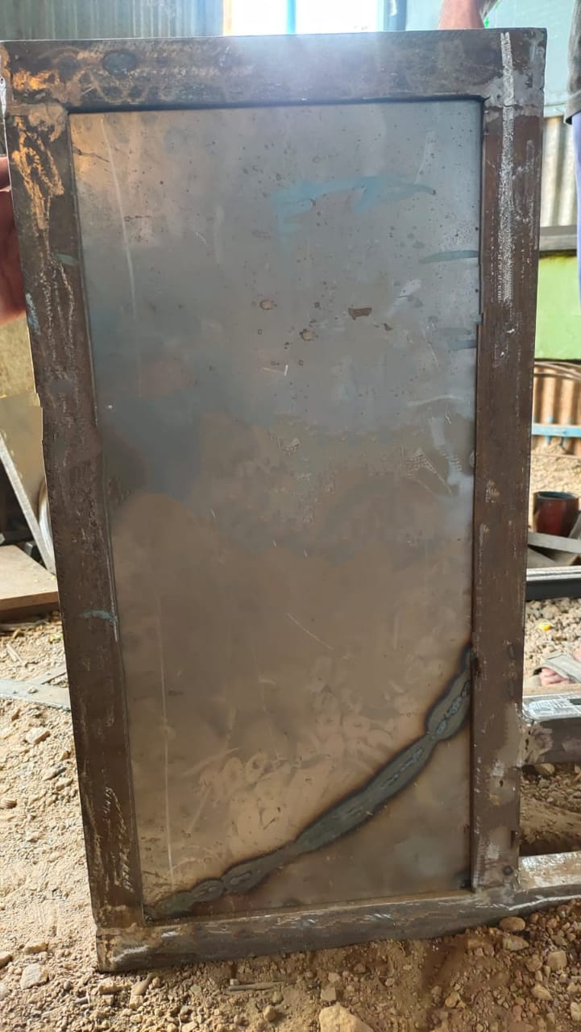
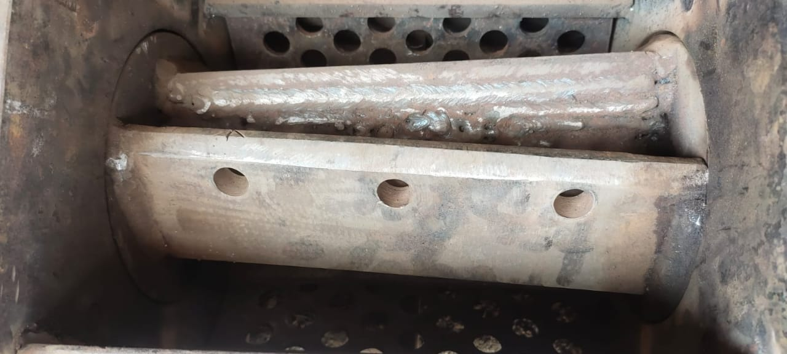
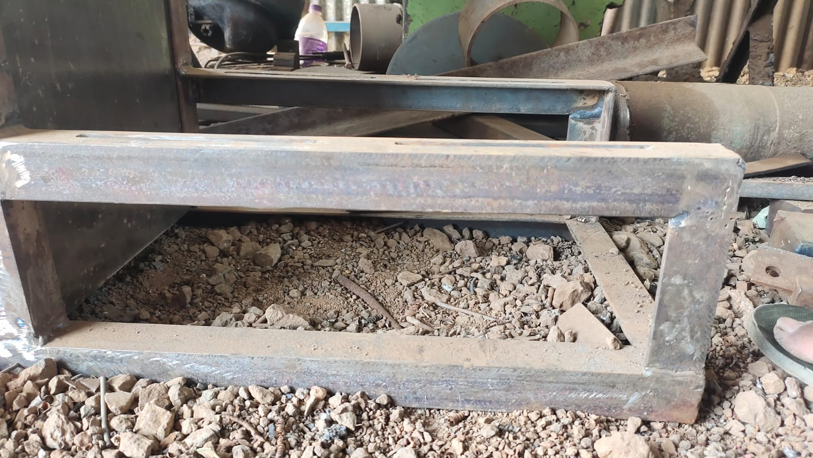
Completed Work:-
Base
Frame
Rotor

Slide 14
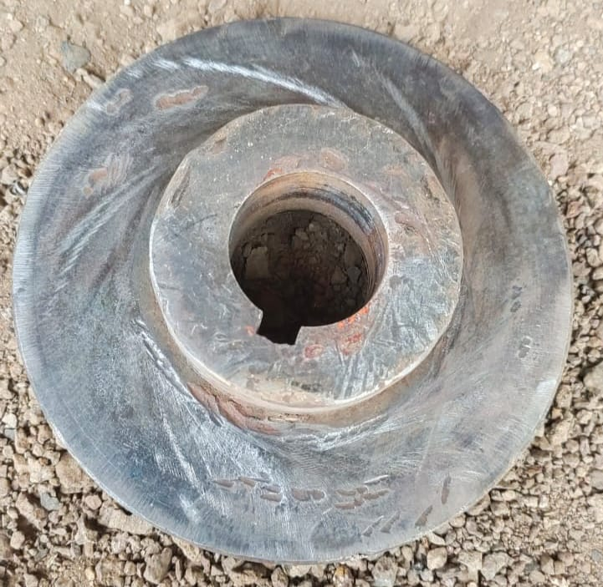
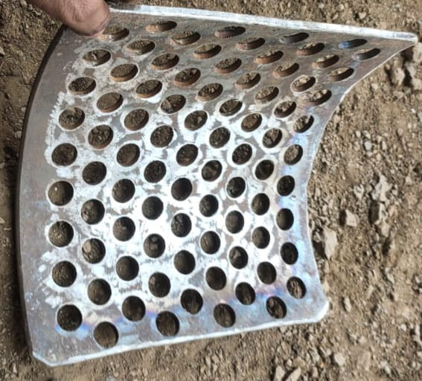
Driven Pulley
Mesh

Slide 15
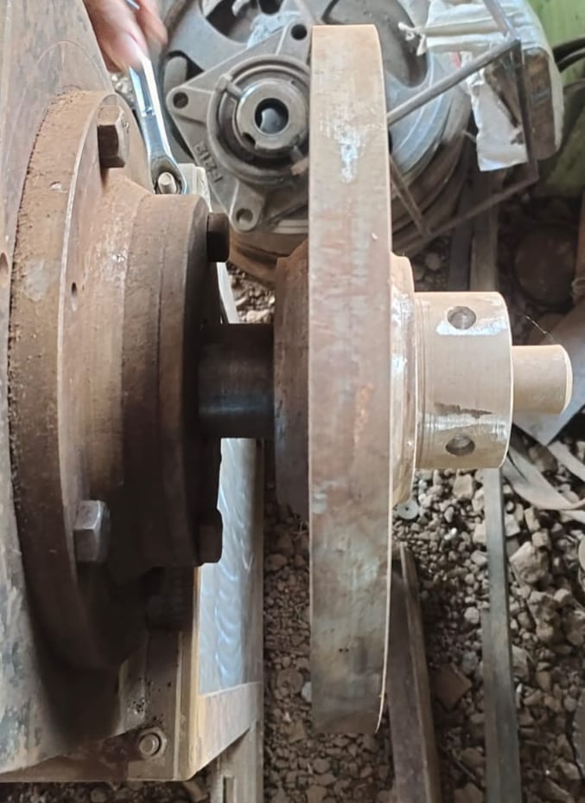
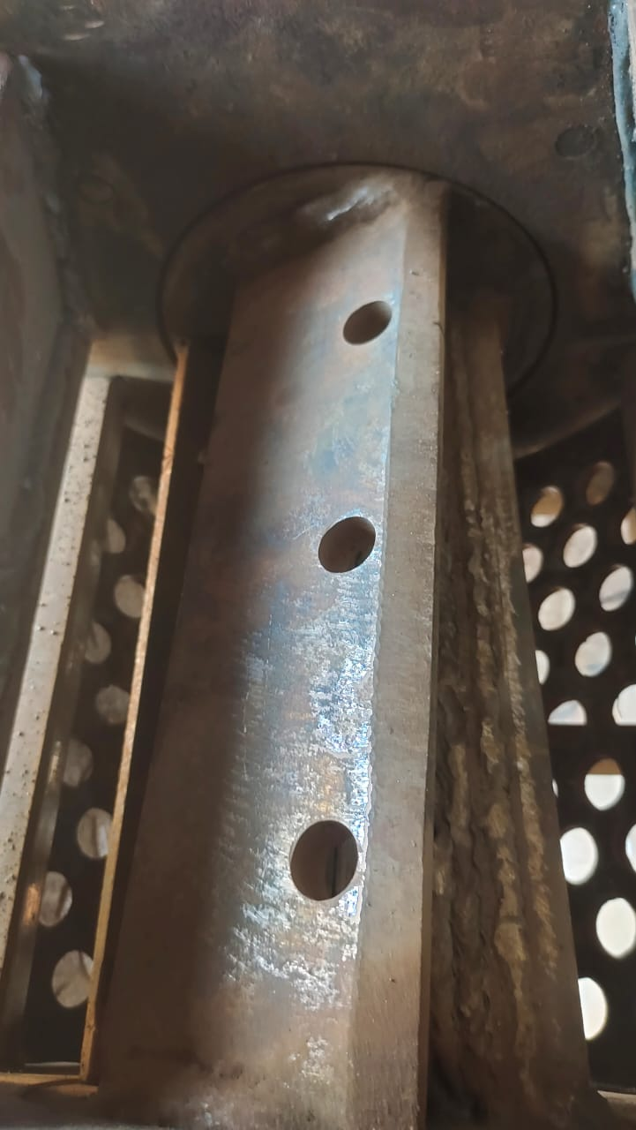
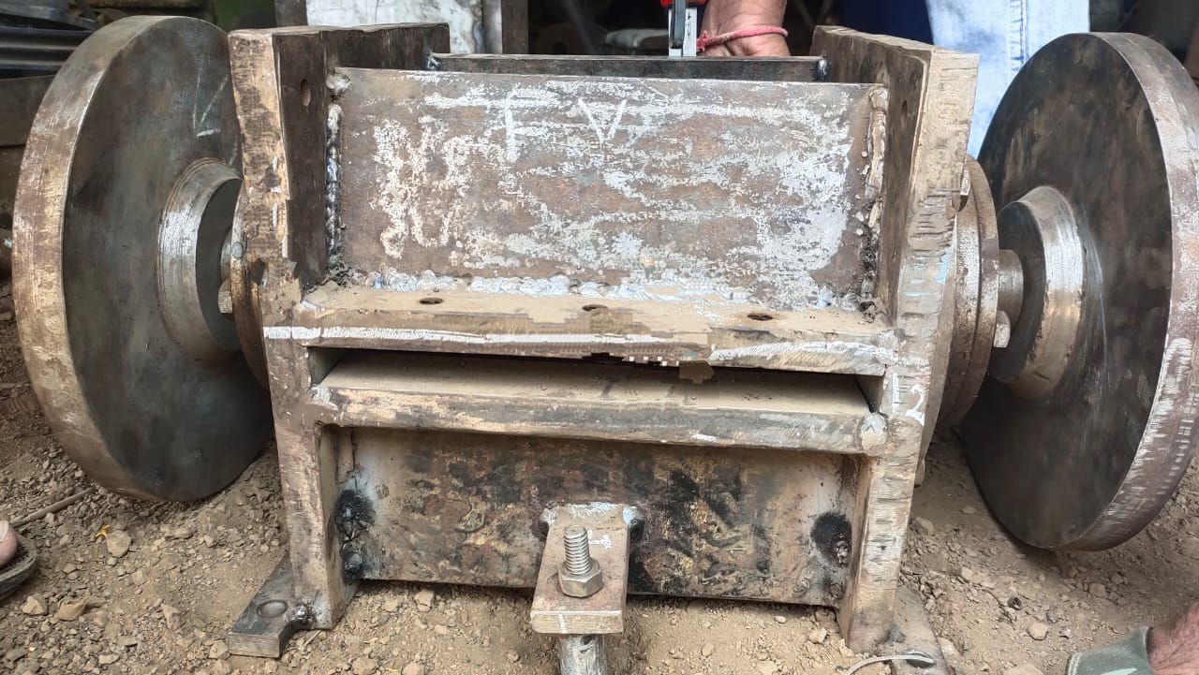
Rotating Disc
Rotor
Front view of coutter assembly

Slide 16
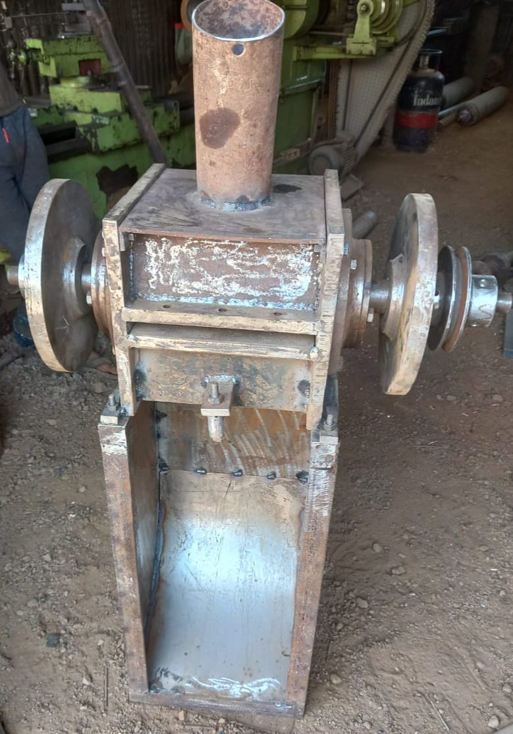
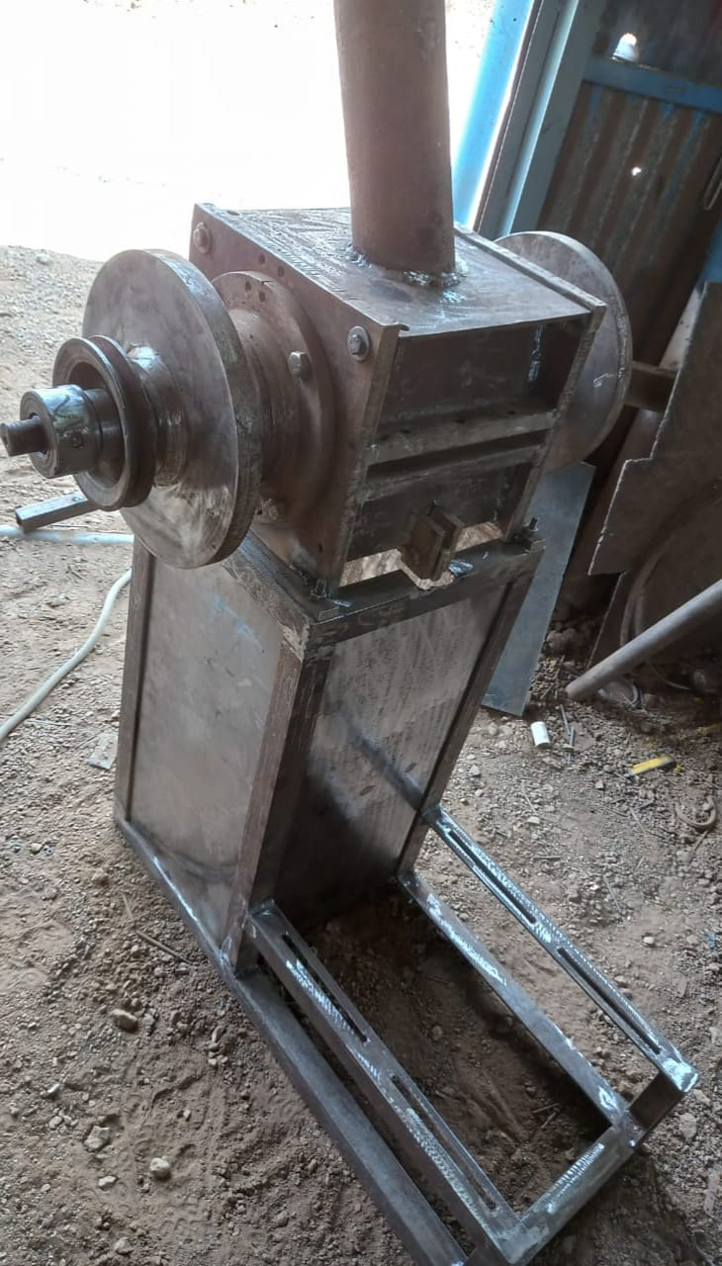
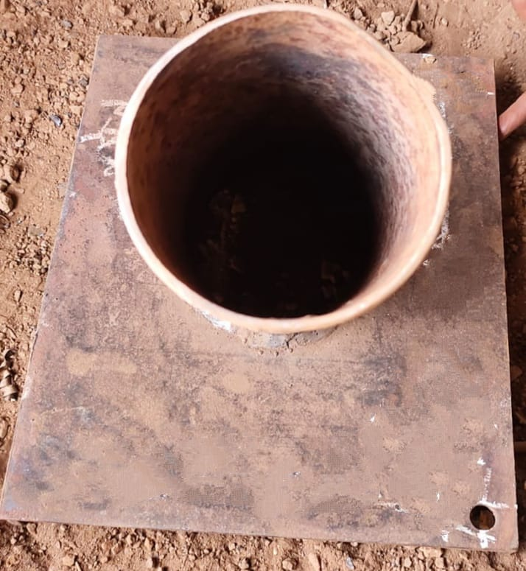
Hopper
Front view of machine
Side view

Slide 17
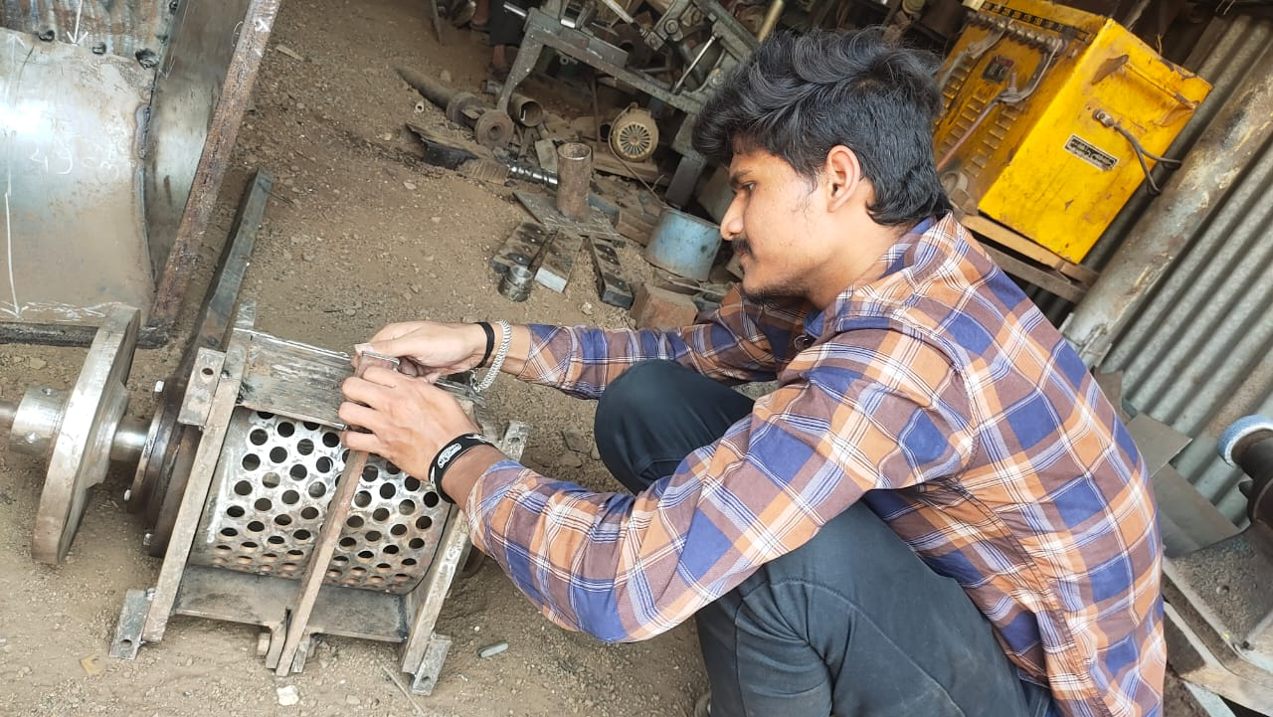
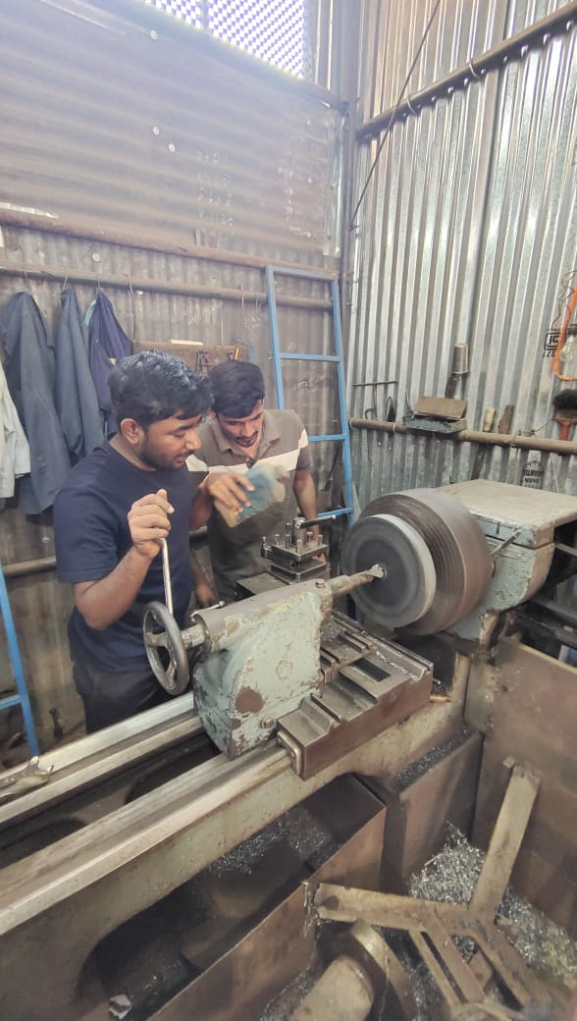
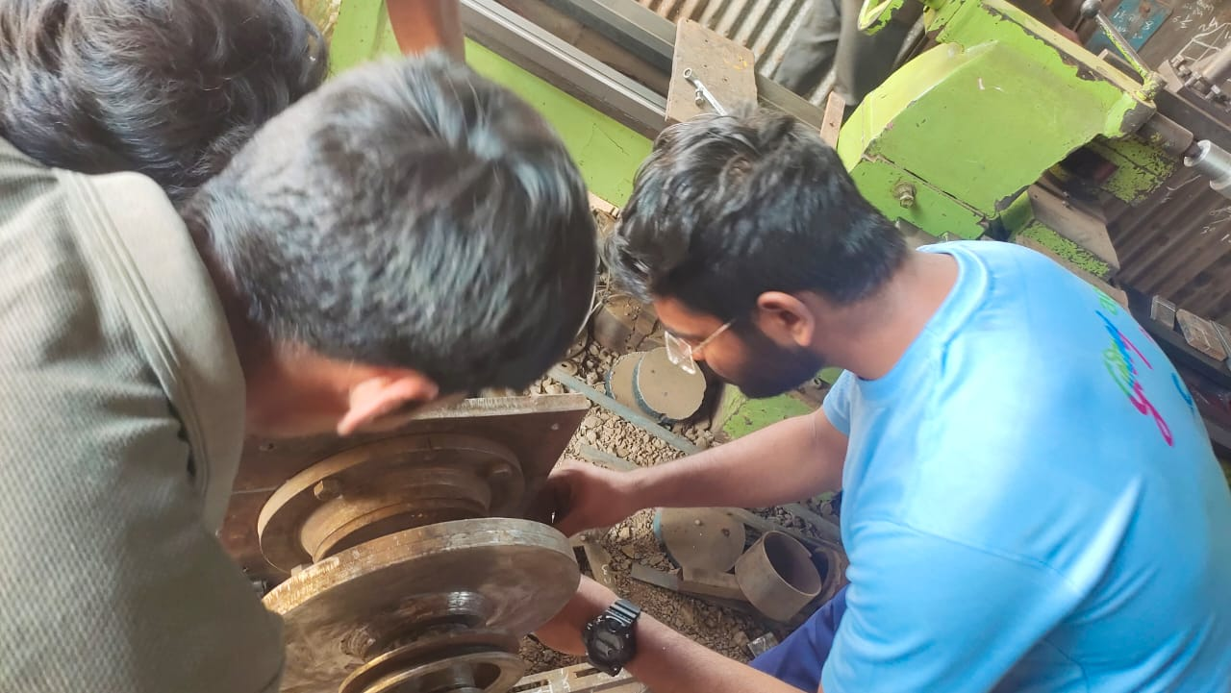

Slide 18
THANK YOU

